Slide 1

INT 400 Internship
Final Review
POSTURE ANALYSIS FOR GYM WORKOUT
Team Members
Project Guide
ARJUN R
AAKASH S
SANTHOSH D
E0120018
E0120005
E0120009
Prof. Ramya M

Slide 2
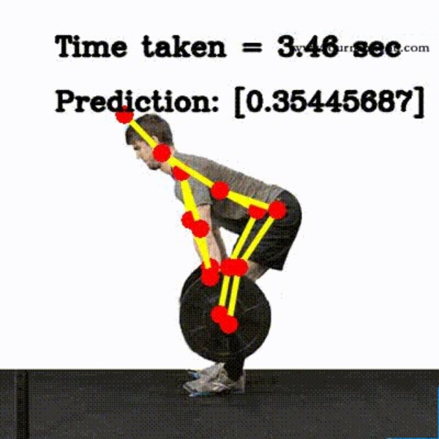
Problem statement
Many gym-goers struggle with keeping track of their workout progress and setting realistic fitness goals. They often rely on memory or scattered notes to track their exercises and weights, leading to inconsistent data and difficulty in measuring progress. This makes it challenging to measure progress and stay motivated, leading to potential workout plateau or giving up on fitness goals. The goal of this project is to develop a user-friendly workout tracker that allows gym-goers to easily log and track their exercises, weights, and progress, helping them stay motivated and on track towards achieving their fitness goals.

Slide 3

Objectives
To develop an AI-powered workout tracking app that allows users to log and track their exercises, helping them achieve their fitness goals more efficiently and effectively.

Slide 4
Research/Product survey
“Robust vision based workout analysis using diversified deep latent variable model,” in 2020 42nd Annual International Conference of the IEEE Engineering in Medicine Biology Society (EMBC), pp. 2155–2158, 2020.
“Real-time yoga recognition using deep learning,” Neural Computing and Applications, vol. 31, pp. https://link.springer.com/article/10.1007/s00521–019, 12 2019.
“Home-based physical therapy with an interactive computer vision system,” in 2019 IEEE/CVF International Conference on Computer Vision Workshop (ICCVW), pp. 2619–2628, 2019.
“Computer-assisted yoga training system,” Multimedia Tools and Applications, vol. 77, 09 2018.
“Pose trainer: Correcting exercise posture using pose estimation,” 03 2018.

Slide 5
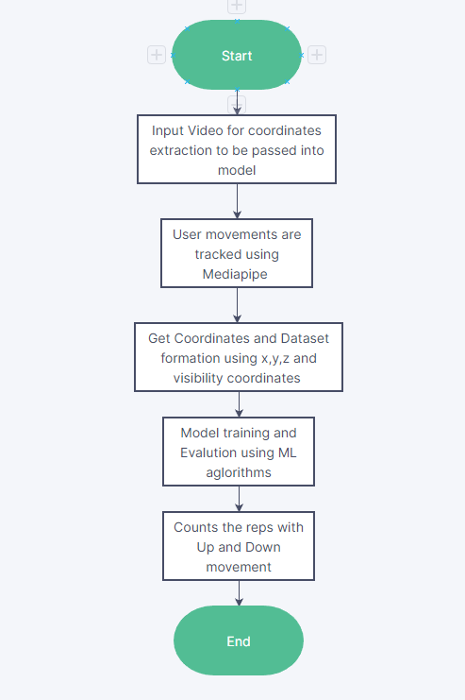
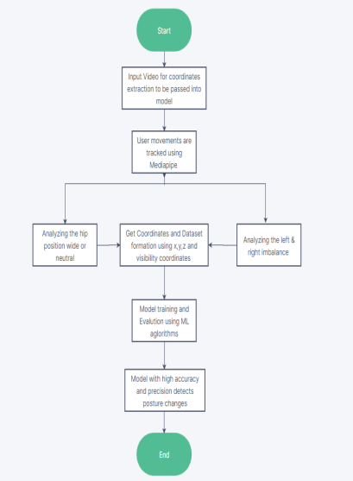
FLOWCHART

Slide 6
WorkFlow
This project analyzes video of the deadlift (one of the most fundamental weightlifting exercises) and scores the posture of the person performing the deadlift from a range of 0 to 1.
This process can be simplified into a few main parts listed below:
1. Firstly, one must work on getting the source video to be passed on the model and openCV detects the video using videocapture function.
2. Then the model works on video training and gets the height, width and fps .
3. The system must read the input video uploaded by the user as a set of coordinates in the landmarks of x,y & z.
4. Selected coordinates of the movement in deadlift gets stored in csv file with a visibility mark.
5. The dataset gets normalised using standscalar and various ML algorithms like logistic regression, ridge classifier, random forest classifier and gradient boosting classifier are used to train the model.
6. Accuracy and precision for each algorithm been labeled using evaluation metric and
pickle helps in save and load the modal.
7. By using the key points, the skeletal structure or stick figure generated and the angles between the various limbs and other body parts could be determined.

Slide 7
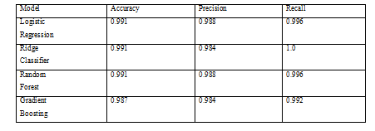
Model Metrics
Random Forest Classifier dominates over the Gradient boosting classifier with an accuracy of 78% . Ridge Classifier and Logistic Regression are simpler algorithms that can be faster to train and easier to interpret, but may not perform as well on complex datasets.
Shows the model's performance using appropriate metrics, such as accuracy, precision and recall on the test set.

Slide 8
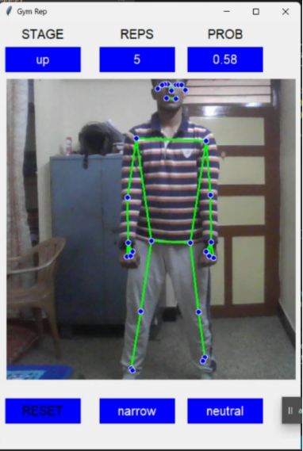
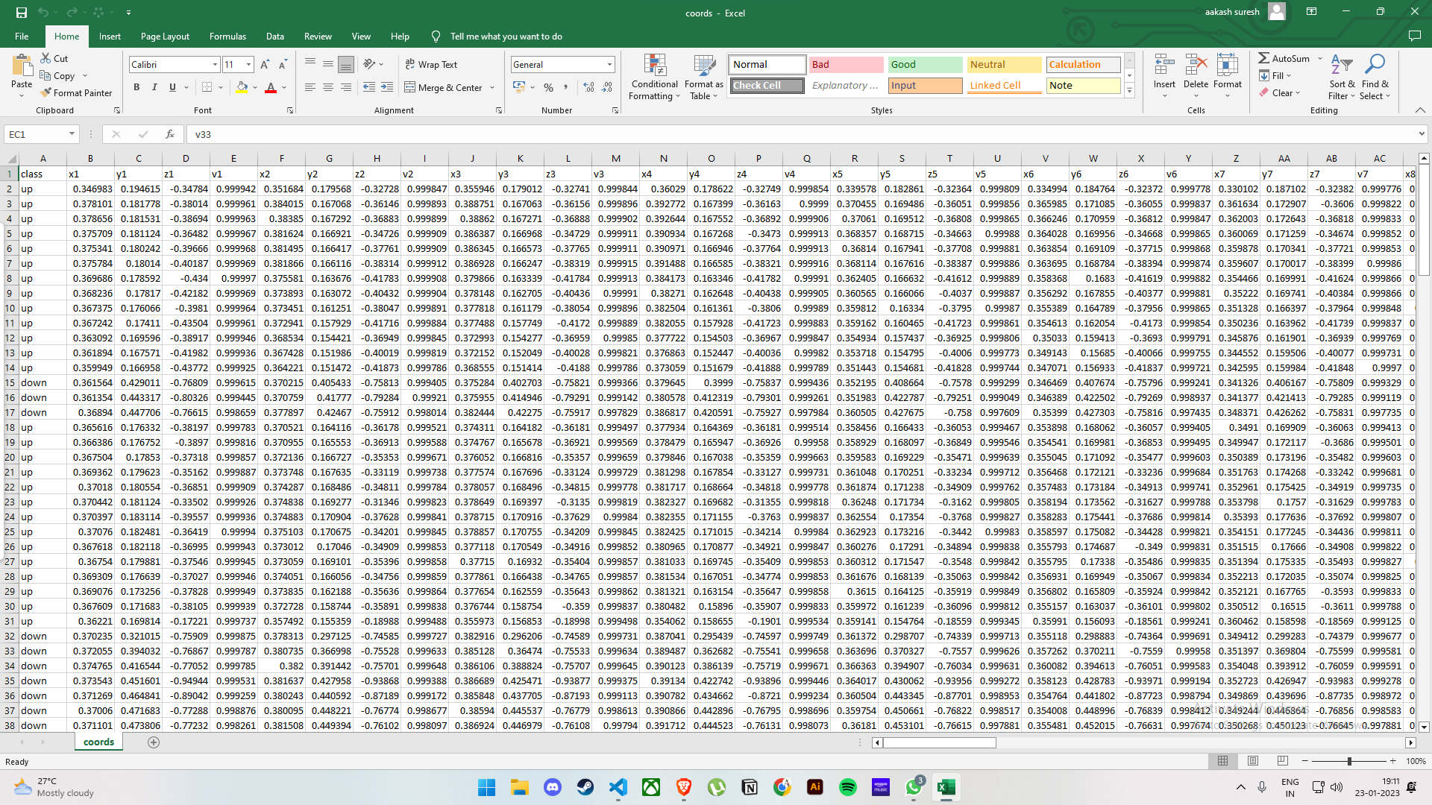
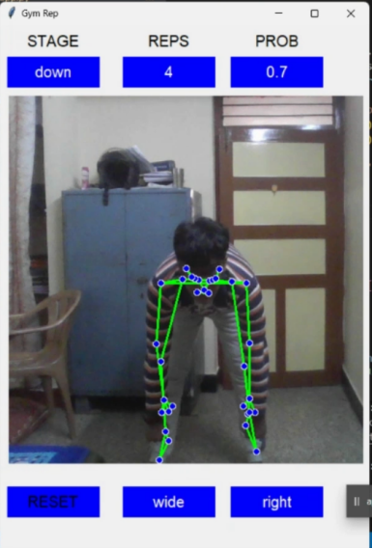
Deadlift Dataset - Concentric and Eccentric phases

Slide 9
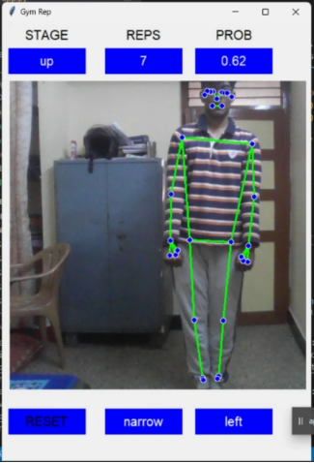
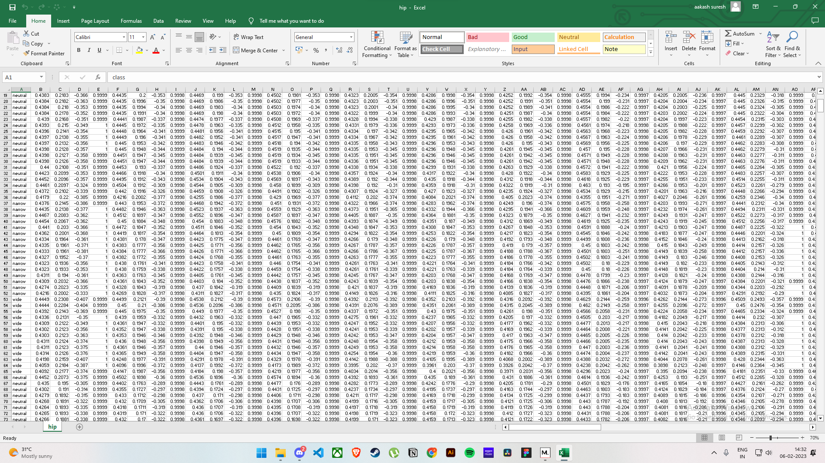
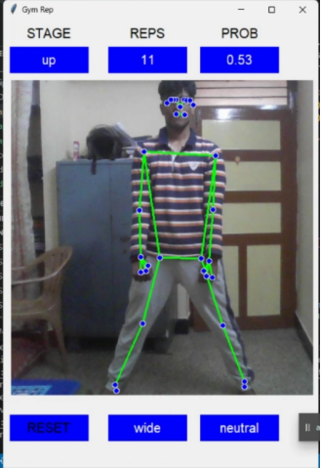
Posture Detection - Hip Positioning

Slide 10
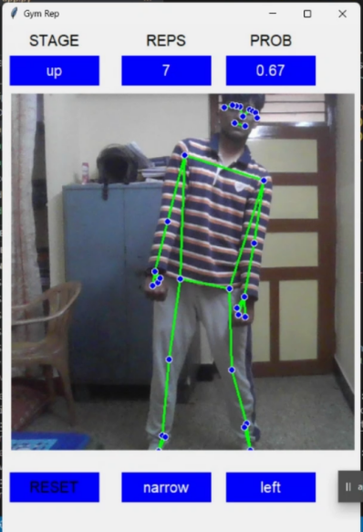
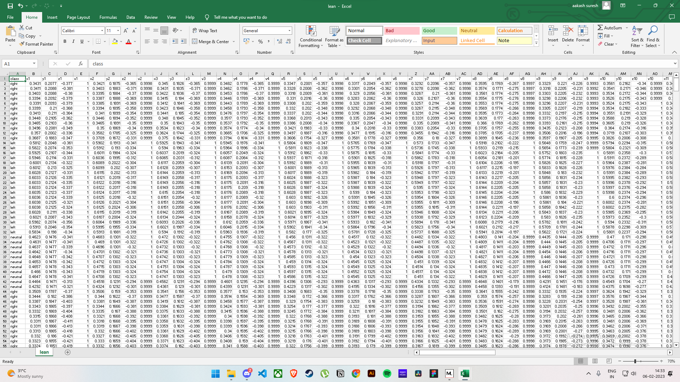
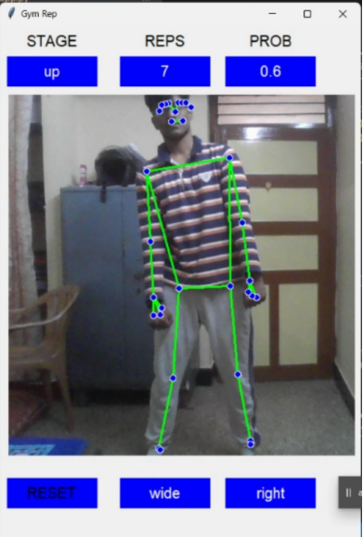
Posture Detection: Left grip and Right grip

Slide 11
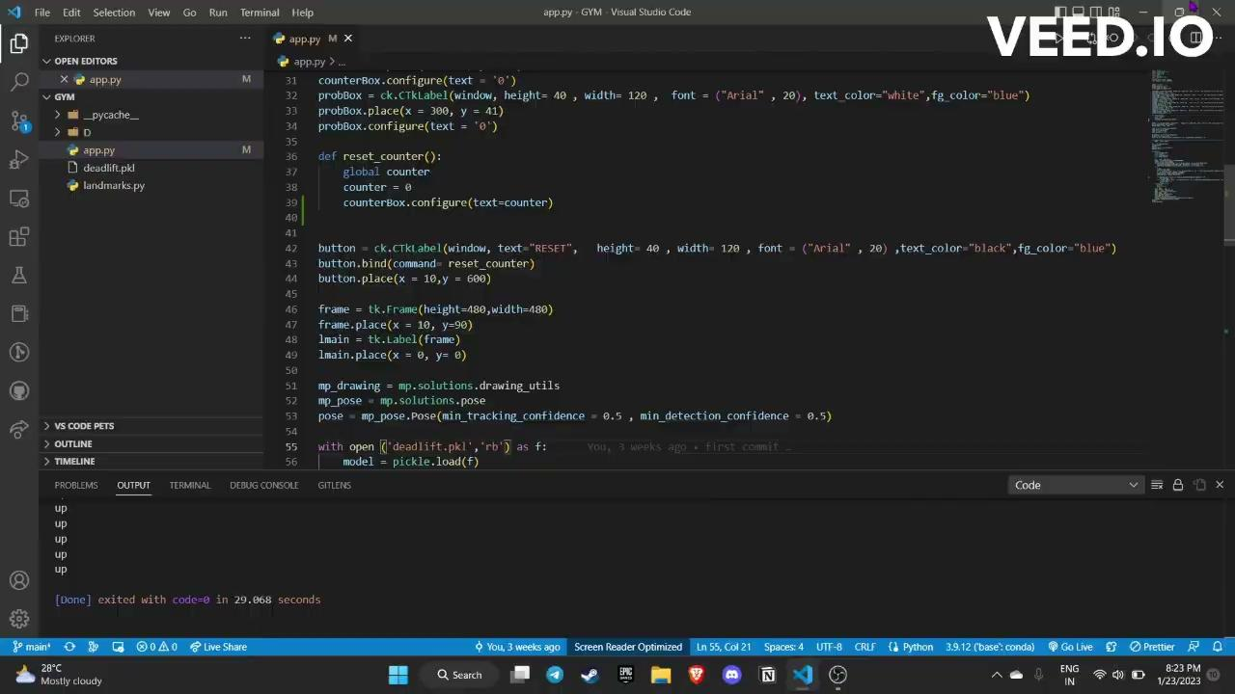
Live Demo

Slide 12
FUTURE APPLICATIONS
Based on human pose estimation, we can build a variety of applications, like fitness or yoga trackers. As an example, we present left bicep curl, plank and push up counters, which can automatically count user statistics and verify the quality of exercises performed. Such use cases can be implemented either using an additional classifier network or even with a simple joint pairwise distance lookup algorithm, which matches the closest pose in normalized pose space.
In future the accuracy of the angles between the joints and limbs can be improvised by using high quality cameras and high graphics. Also the factors like height weight and and a person's diet could be included to get better results
.
A User portal that keeps a track and record of the data of their previous exercises performed in the system’s database. Variation can be brought by adding sections for men, women, and children depending on their age group and segregating different sections based on the difficulties of the exercises.

Slide 13
TIMELINE
Model Creation and evaluation
Realtime Implementation
Project Identification
MediaPipe model testing
1
2
3
4
Collection of assets
data creation and training.
Final Results Evaluation

Slide 14
References
https://www.infoq.com/articles/human-pose-estimation-ai-powered-fitness-apps/
https://paperswithcode.com/paper/domain-knowledge-informed-self-supervised
https://www.youtube.com/watch?v=06TE_U21FK4
https://github.com/quanhua92/human-pose-estimation-opencv
https://ijcrt.org/papers/IJCRT2205886.pdf
https://google.github.io/mediapipe/solutions/pose_classification.html
https://www.youtube.com/watch?v=H7cGq0xIHbc
https://learnopencv.com/ai-fitness-trainer-using-mediapipe/

Slide 15
Thank you

